Slide 1
Pre-Class
I
Directions:
Complete the Bell Ringer worksheet.
Make sure you have a sharp pencil!
5 minutes

Slide 2
Review
2.5 minutes
IIa

Slide 3
Review
2.5 minutes
IIb

Slide 4
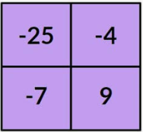
Hook
III
1.5 minutes
Directions: Think, which one does not belong? We will discuss in 1 minute.

Slide 5
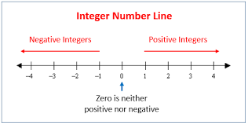
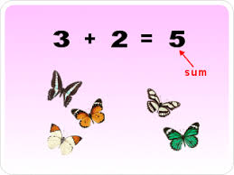
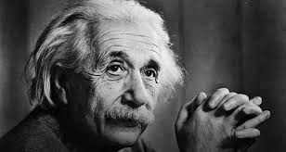
Focus Question
IVa
30 seconds
How can mathematicians use a horizontal number line to add integers?

Slide 6
Focus Question
IVb
30 seconds
By the end of the lesson, you can say…
I can use a horizontal number line to add integers.
I can explain that a sum of a number and its opposite is zero.

Slide 7
1 minute
Prerequisite Information
V
Integers are whole numbers and their opposites
Examples:
5, 4, 3, 2, 1, 0, -1, -2, -3, -4, -5

Slide 8
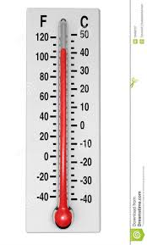
Real World Connection
VI
1 minute
Anchorage, Alaska
Jackson, Mississippi
Month | Low | High
August | 49.4°F | 63.3°F
Month | Low | High
August | 65°F | 97°F

Slide 9
Importance/Relevance
VII
30 seconds
Integers are important because it helps us be more precise with our calculations when solving mathematical problems.

Slide 10
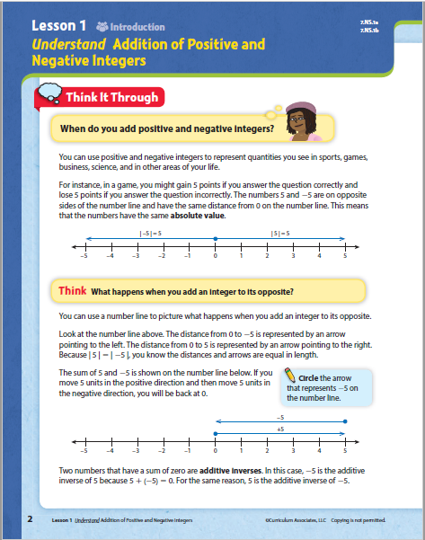
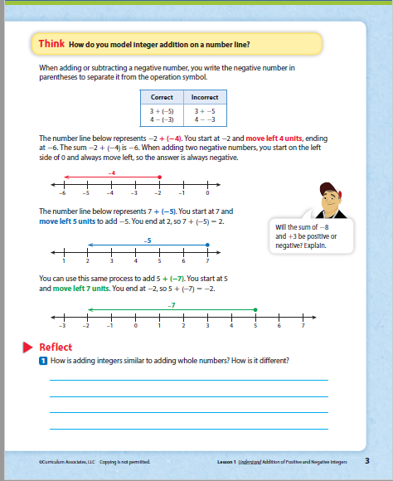
Teacher Input
1
30 seconds
Directions: Turn in their instruction workbooks to pages 2 & 3.

Slide 11
Teacher Input
2
15 seconds
Lesson Vocabulary
absolute value
additive inverse
integer

Slide 12
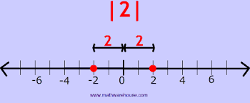
Teacher Input
4
45 seconds
absolute value
$\left|10\right|$= 10
$\left|−10\right|$= 10
This notation is to express a numbers distance from zero on a number line.
$\left|2\right|$= 2
$\left|−2\right|$= 2

Slide 13
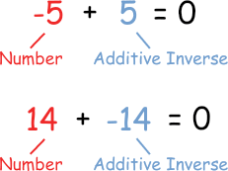
Teacher Input
4
1 minute
additive inverse
a number you add to another number to equal zero.
This is also known as the opposite number.
x + (-x) = 0
(-x) + x = 0.

Slide 14
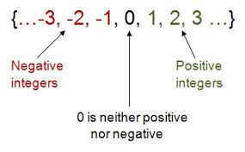
Teacher Input
5
30 seconds
integer
whole numbers and their opposites
Examples:
5, 4, 3, 2, 1, 0, -1, -2, -3, -4, -5

Slide 15
Teacher Input
6a
3 minutes

Slide 16
4 minutes
Teacher Input
6b

Slide 17
1 minute
7a
Teacher Modeling

Slide 18
1 minute
7b
Teacher Modeling

Slide 19
30 seconds
8a
Teacher Modeling

Slide 20
2 minutes
Teacher Input
8b
Adding integers is similar to adding whole numbers since… It is different because…

Slide 21
30 seconds
9
Educational Brain Break

Slide 22
5 minutes
Educational Brain Break
Directions:
Get out of your seat.
Find a classmate that has your additive inverse.
There will only be one person that has it.

Slide 23
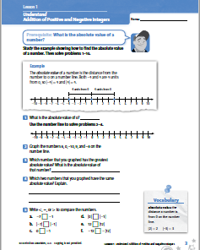
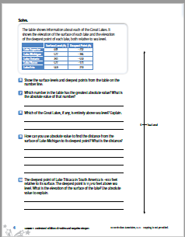
10 minutes
Guided Practice
Directions:
Turn to page 3 in your practice workbook.
Tear this page out.
Complete questions 1-10.
(What you do not finish is homework.)

Slide 25
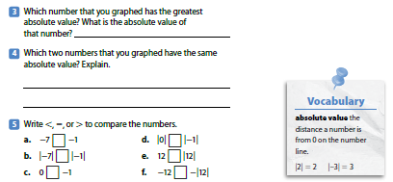

Slide 27
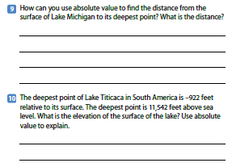

Slide 28
2 minutes
Closure
Absolute Value: is a notation to express a numbers distance from zero on a number line.
$\left|2\right|$= 2 & $\left|−2\right|$= 2
Additive Inverse is a number you add to another number to equal zero. This is also known as the opposite number.
x + (-x) = 0
(-x) + x = 0.
Integers are whole numbers and their opposites.
Examples: 5, 4, 3, 2, 1, 0, -1, -2, -3, -4, -5

Slide 29
3 minutes
Exit Ticket
How can mathematicians use a horizontal number line to add integers?
Name_________________________
Period:_____
Date:___________
EXIT TICKET
Directions: Answer today’s Focus Question(s) in the space below.

