Slide 1
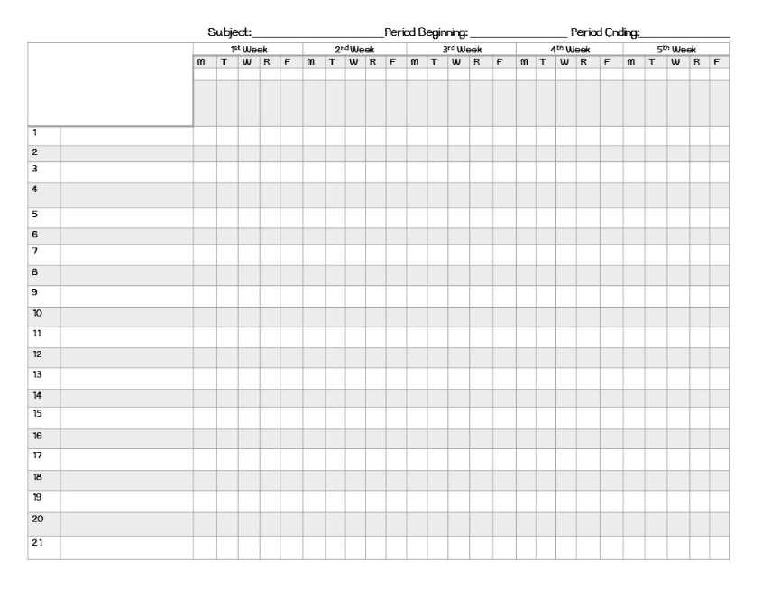
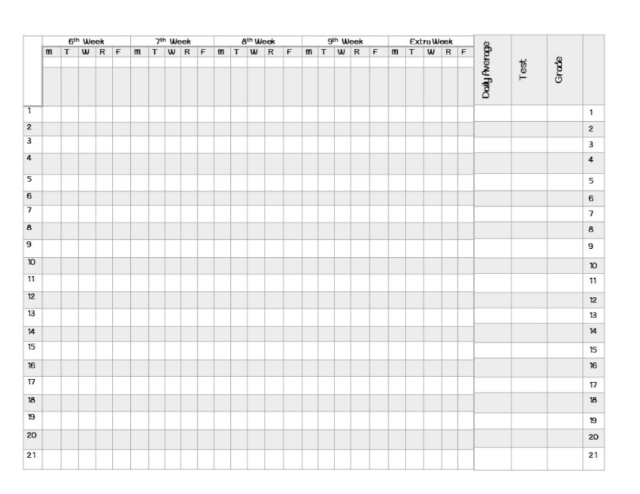
Teacher’s Record Book
Created by: Dance Party in Room 15

Slide 2
Dear Teacher,
What you are purchasing is a record book to keep track of student grades and other important information. This item includes:
1) Beautiful Binder Cover
2) Title page to record your teacher schedule
3) Special Calendar of Events
4) Passwords page
5) Substitute teacher information
6) Parent Directory (Portrait & Landscape)
7) Parent Contact Documentation
8) Student Seating Chart
9) Grades Recording Page (2 Versions: 1 holds 21 names and
the other holds 13) These pages extend for a 9 weeks.
Note: Once I started grouping my students by ability and differentiating to accommodate all students on each level, I started using a smaller grade book sheet for each group. (This is why I included the page with only 13 spots.)
Created by: Dance Party in Room 15

Slide 3
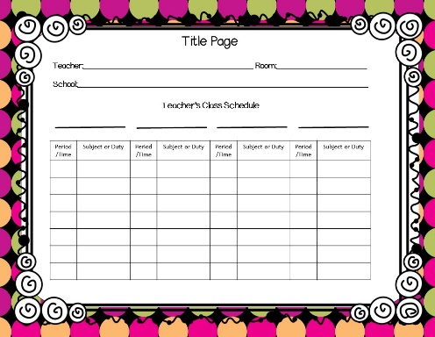
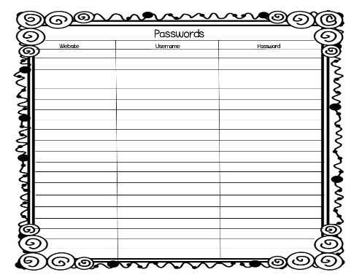
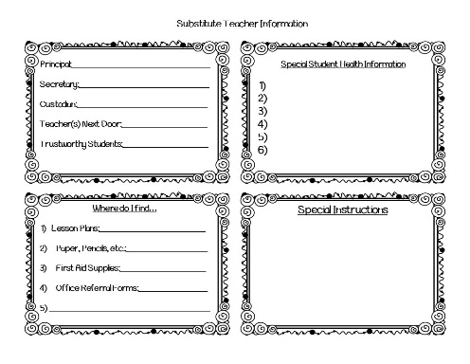
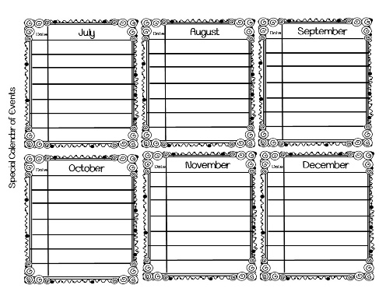
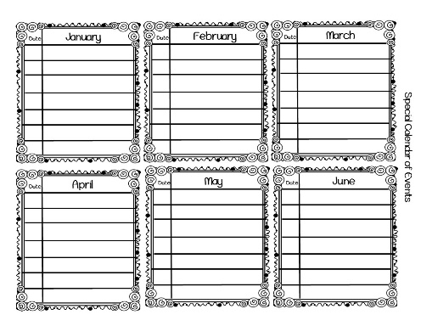
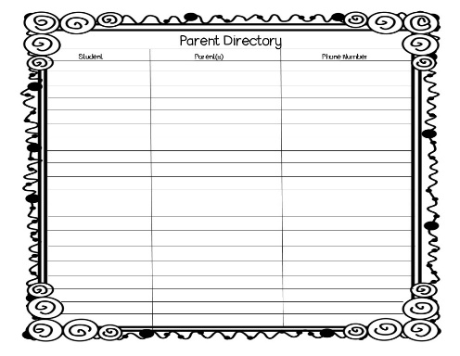
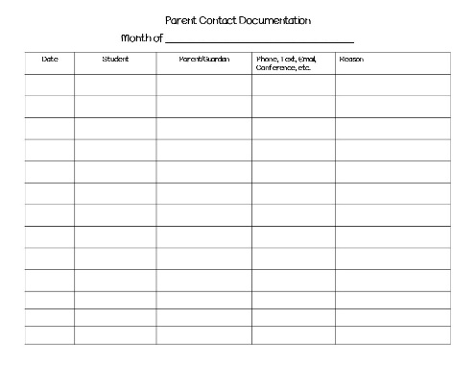
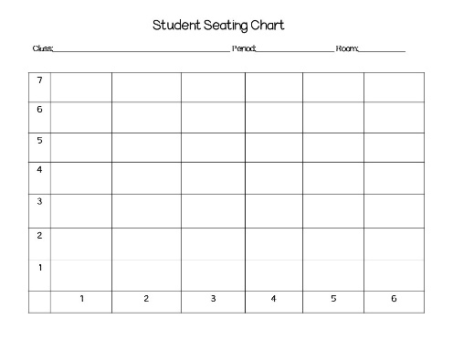
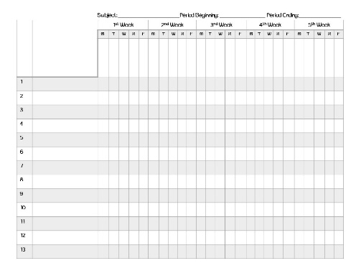
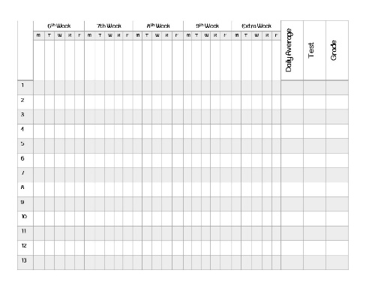
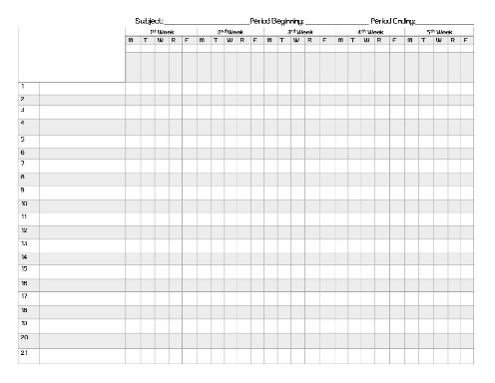
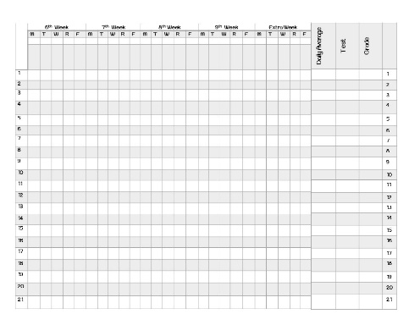
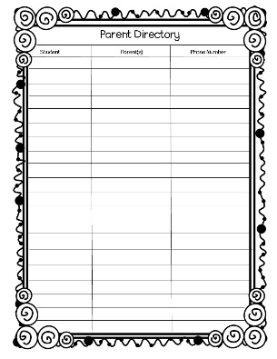

Slide 4
Subject: _______________________Period Beginning: _________________ Period Ending:________________
 |  | 1st Week |  |  |  |  | 2nd Week |  |  |  |  | 3rd Week |  |  |  |  | 4th Week |  |  |  |  | 5th Week
 |  | M | T | W | R | F | M | T | W | R | F | M | T | W | R | F | M | T | W | R | F | M | T | W | R | F
1
2
3
4
5
6
7
8
9
10
11
12
13

Slide 5
 | 6th Week |  |  |  |  | 7th Week |  |  |  |  | 8th Week |  |  |  |  | 9th Week |  |  |  |  | Extra Week
 | M | T | W | R | F | M | T | W | R | F | M | T | W | R | F | M | T | W | R | F | M | T | W | R | F
1
2
3
4
5
6
7
8
9
10
11
12
13
Daily Average | Test | Grade

Slide 6
Thank you!!!
Krista Wallden for the whimsical graphics
My newest favorite font, Teaching Rounding, was free at the link directly below!
http://www.teacherspayteachers.com/Store/Krista-Wallden
http://www.teacherspayteachers.com/Store/Speech-Therapy
Laura Randazzo for the fun multi-colored background!
https://www.teacherspayteachers.com/Store/Laura-Randazzo
For the ribbon borders for the record book cover:
Teacher’s Gumbo
http://www.teacherspayteachers.com/Store/Teachers-Gumbo

Slide 7
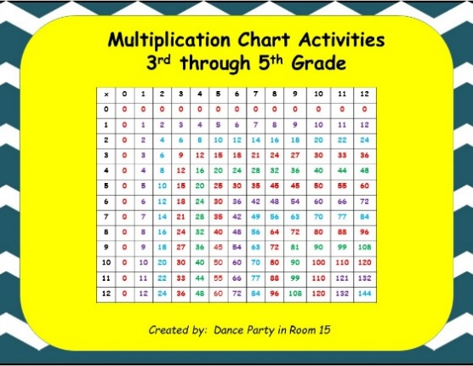
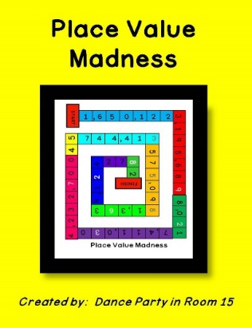
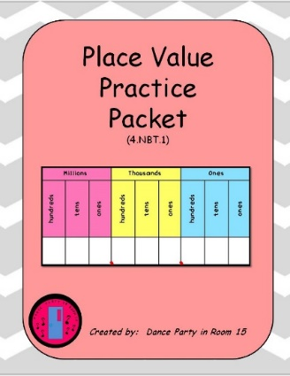
Check out some of my other products!

Slide 8
Please check out my blog at
dancepartyinroom15.blogspot.com
for freebies and ideas for your classroom!

