Slide 1
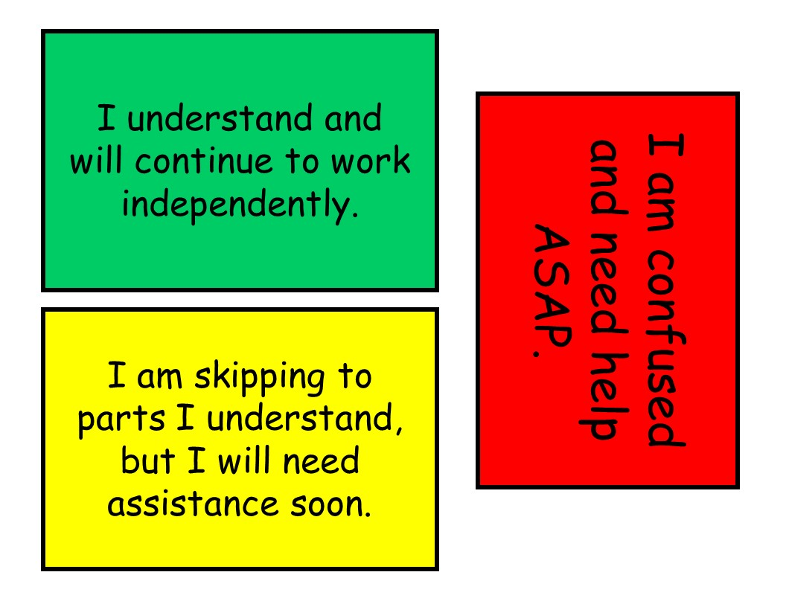
Teacher’s Seatwork Helper
***Quickly Determine while students need help with this tool!
Created by: Dance Party in Room 15

Slide 2
Dear Customer,
This tool may be used while students are working independently or in groups to alert you if they need help. This will allow students to not keep their hands raised while they wait for you to assist them. (You may also scan the room to see if the assigned task needs further explanation.) I have included one page if you would like to print in color. I have also included a printer friendly black and white version. (I would print this version with three different colors of paper.)
Directions:
Print as many copies as your largest class.
Laminate, cut, and attach to a book ring.
Hope this helps!
Dance Party in Room 15

Slide 3
I understand and will continue to work independently.
I am confused and need help ASAP.
I am skipping to parts I understand, but I will need assistance soon.

Slide 4
I understand and will continue to work independently.
I understand and will continue to work independently.
I understand and will continue to work independently.

Slide 5
I am skipping to parts I understand, but I will need assistance soon.
I am skipping to parts I understand, but I will need assistance soon.
I am skipping to parts I understand, but I will need assistance soon.

Slide 6
I am confused and need help ASAP.
I am confused and need help ASAP.
I am confused and need help ASAP.

