Slide 1
Welcome to 7th Grade Math!
Materials Needed:
2 pocket folder with prongs
Four function calculator
Highlighter
Pencils
Pens
Instructor: Mrs. Ali Mack
Room:
School Phone #:
Phone #:
Website:
Email:
Course Description
In this course, we will study The Number System, Ratios & Proportional Relationships, Expressions & Equations, Geometry, and Statistics & Probability. Students will be given many opportunities to practice the skills taught. Assessments will be given three times during a 9 week period. Students are required to complete 45 minutes of iReady math every week with a pass rate of 80% once initial diagnostic testing is completed. (Completing homework, reviewing notes, handouts, and already solved problems daily will be essential to student achievement.)
Classroom Rules
HOMEWORK POLICY
Respect yourself, classmates, and teacher.
Listen and follow directions.
Do not talk while the teacher is talking.
Only one person on the floor at a time.
No distractions: No food. No grooming. No electronics.
Homework can be assigned Monday-Friday for all students in this class. Homework ensures that we are practicing our skills daily. Homework is expected to be completed the night it is assigned so students can bring any questions the following day for review.

Slide 2
Possible Consequences
The severity of the consequence will depend on the students’ action(s). Here are some of the consequences I deliver in my class.
Warning | Written Warning | Teacher-Student Conference
Seat Change | Lunch Detention | Afterschool Detention
In Class Detention (ICD) | Parent Contact | Loss of Privilege
Counselor Referral | Recommend student to the TST Committee | Office Referral
Guaranteed Consequences
If a student breaks something, he or she will fix it.
If a student leaves a mess, he or she will clean it.
If a student is eating in my class, I will immediately throw his or her snack away.
If a student is not working during my class, he or she will immediately be assigned afterschool detention to complete the work.
If a student teases or is disrespectful to his or her classmates or me, I will contact the parent/guardian and assign the student afterschool detention.
If a student continues to talk during inappropriate times, he or she will be isolated from his or her classmates.
If a student does not follow transition procedures, he or she will be assigned afterschool detention to practice these procedures with the teacher.
Grading
Absences
Assessments are worth 70% of the child’s grade.
Daily assignments are worth 30% of the child’s grade.
I do NOT accept late work.
GPA | % Mastery Range
3.60-4.00 | 90-100
3.20-3.59 | 80-89.9
2.80-3.19 | 70-79.9
2.40-2.79 | 60-69.9
< 2.40 | <60
If you are absent, you will be given make-up work upon your return to school.
However many days you missed, is how many days you have to turn in the missed assignment.
It will be a zero if not turned in within the allotted amount of time.
Students are responsible for turning this work in on time.

Slide 3
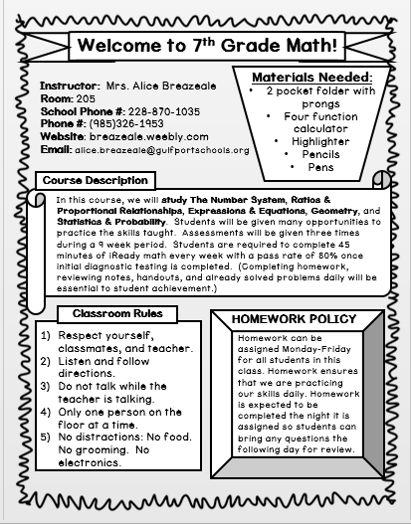
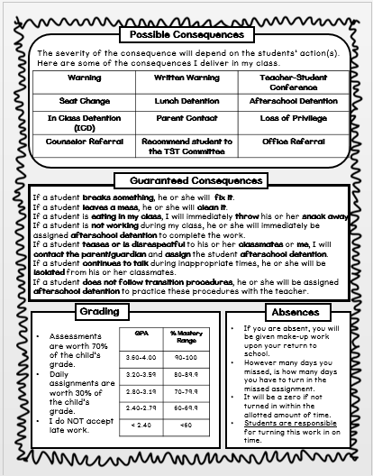
Please Sign & Return
I acknowledge that I understand the rules, consequences, and policies of this classroom for the 2019-2020 school year.
Student Signature: ____________________ Date:_______
Parent Signature: _____________________ Date:_______

Slide 4
Questions, Comments, Concerns
Please list any questions, comments, or concerns you might have. I will do my best to get back with you. Please leave me your email address or phone number.

